Slide 1
Restorable Logical Topology using Cross-Layer Optimization
Enas Massarwa
Louie Abu Warda

Slide 2
Introduction
The construction of a logical network on top of a physical network involve two intertwined tasks:
Logical link selection: deciding which pairs of routers will be connected by logical links.
Logical link routing: deciding how to route each logical link across the optical network.
The ultimate goal of the network operator is to:
Maximize available throughput.
Guarantee the network’s restorability.
⇒Maximize restorable throughput.

Slide 3
Introduction
When there is no prior knowledge of users’ bandwidth demands, minimizing the network’s Shared Risk Link Groups (SRLG) is a well-known optimization criterion to maximize the restorable throughput.
An SRLG of a physical link e is the set of all logical links routed over e.
The cardinality of the SRLG associated with a physical link is known to be a good indicator of the damage to the logical network if this link fails.
We seek to minimize the maximum cardinality of the SRLGs over all physical links.

Slide 4
The Problem: Input & Output
Input:
Physical network, represented as:
G_{p}=(V_{p}, E_{p}), an undirected graph, where
V_{p} is the set of physical switches,
connected by the set E_{p} of physical links.
A subset of V_{p}, labelled V_{L}, serve as routers.
C_{p}, capacity of each link. C_{p} ≥ 2 and is even.
Budget of the topology (B), which is the maximum number of logical links allowed. B ≥ |V_{L}| must hold.
Output: a logical network with a minimal maximum number of logical links traversing a single physical link.

Slide 5
MM-SRLG
This problem is referred to as MM-SRLG in the paper “Restorable Logical Topology in the Face of No or Partial Traffic Demand Knowledge” by Prof. Reuven Cohen and Dr. Gabi Nakibly.
The problem is NP-Complete.
The paper presents an approximation algorithm for MM-SRLG.

Slide 6
The Algorithm
The approximation algorithm is developed in 3 steps:
An algorithm for MM-SRLG(cycle): this step ensures minimum resiliency of the network. If one link fails, the “cycle” that this step aims to create ensures the existence of a secondary path of communication.
An algorithm for MM-SRLG(arb): this step adds additional logical links to the network, utilizing the remaining available budget of logical links.
Solved using the reverse variant of the problem, which in itself is optimally solved through linear programming by an algorithm that is referred to as ALG in the paper.
The final algorithm for MM-SRLG: invokes MM-SRLG(cycle) to produce a logical cycle, and then invokes MM-SRLG(arb) to generate additional logical links such that their total number will be B.

Slide 7
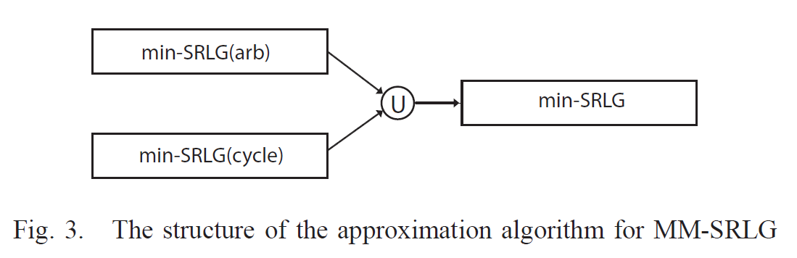
The Algorithm

Slide 8
The Project: What were our goals?
Implement the MM-SRLG algorithm.
Setup Mininet and Ryu and learn how to use them.
Implement a second algorithm and compare it with MM-SRLG in case of link failure.

Slide 9
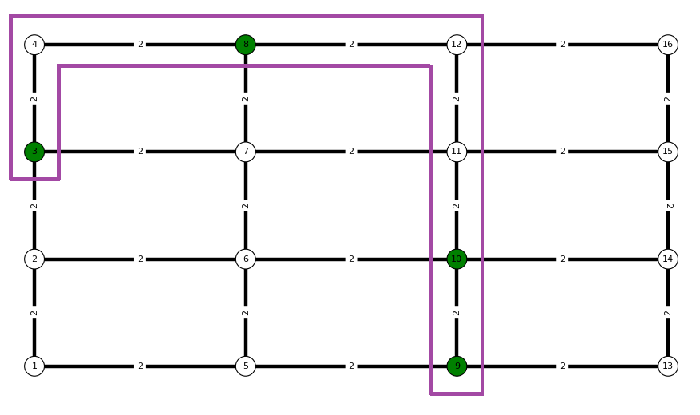
Obstacle & Solution
When trying to implement MM-SRLG(cycle), we found out that, in practice, the algorithm in the paper actually returns a physical tree and not a physical cycle!

Slide 10
Obstacle & Solution
To overcome this, we implemented a variation of MM_SRLG(cycle):
Find a spanning tree on the graph G that spans V_{L}. Then prune all leaves that are not in V_{L}.
Find secondary paths between routers: For each pair (u,v) in the tree’s leaves, if there exists a secondary path between u and v that is different than the one in the spanning tree, and we have already added it to the list of secondary paths, then continue. Otherwise, add this path.
This should ensure that if a physical link that is on the path between u and v in the spanning tree fails, then there is a secondary path outside this tree that connects u and v.

Slide 11
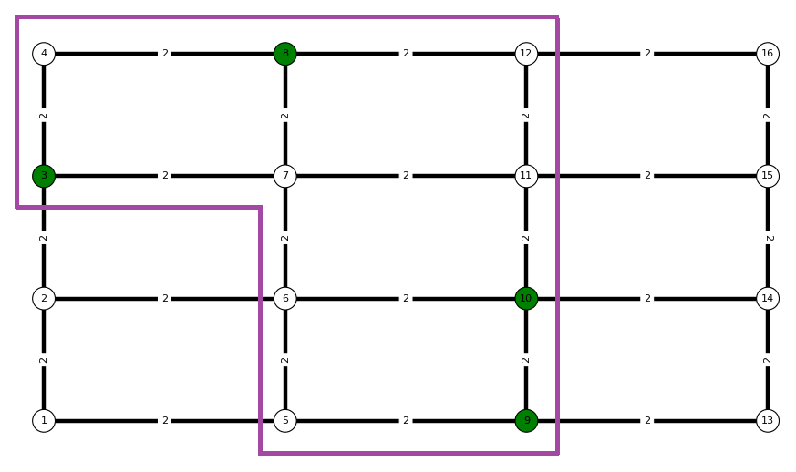
Obstacle & Solution
Using the same example above, this is the result that we receive using our variant of MM-SRLG(cycle):

Slide 12
Environment & Libraries
Mininet VM
RYU Controller
OpenFlow 1.0
Networkx (a Python library for managing graphs and networks)
PuLP - a linear programming toolkit for Python
ovs-ofctl (command line tool for monitoring and administering OpenFlow switches)

Slide 13
Implementation
Modules:
customTopologyInitializer
ALG
MM_SRLG
MM_SRLG_arb
MM_SRLG_cycle
Controller apps:
MM_SRLG-based
Disjoint paths-based

Slide 14
Implementation
Generating a network description file:
myNetwork = dict()
myNetwork['V_P'] = [1, 2, 3, 4, 5, 6, 7, 8, 9]
myNetwork['V_L'] = [1, 4, 8]
myNetwork['E_P'] = [(1, 4), (1, 2), (2, 3), (2, 5), (3, 6), (4, 5), (4, 7), (5, 8), (5, 6), (6, 9), (7, 8), (8, 9)]
myNetwork['C_P'] = 2
myNetwork['B'] = 4
pickle.dump(myNetwork , open("myNetwork.p", "wb"))

Slide 15
Implementation
myNetwork.p
Mininet
(uses ustomTopologyInitializer)
RYU Controller MM_SRLG-based
MM_SRLG
MM_SRLG_cycle
MM_SRLG_arb
ALG

Slide 16
Competing algorithm Based on Disjoint Paths
For every pair of logical nodes:
Find shortest path.
Decrease capacity of path’s edges by 1.
If newCapacity(edge) == 0, remove edge.
B = B – 1.
While B > 0:
For every pair of logical nodes:
Find a path that is disjoint to the paths between the pair that were found so far.
Decrease capacity of path’s edges by 1.
If newCapacity(edge) == 0, remove edge.
B = B – 1.

Slide 17
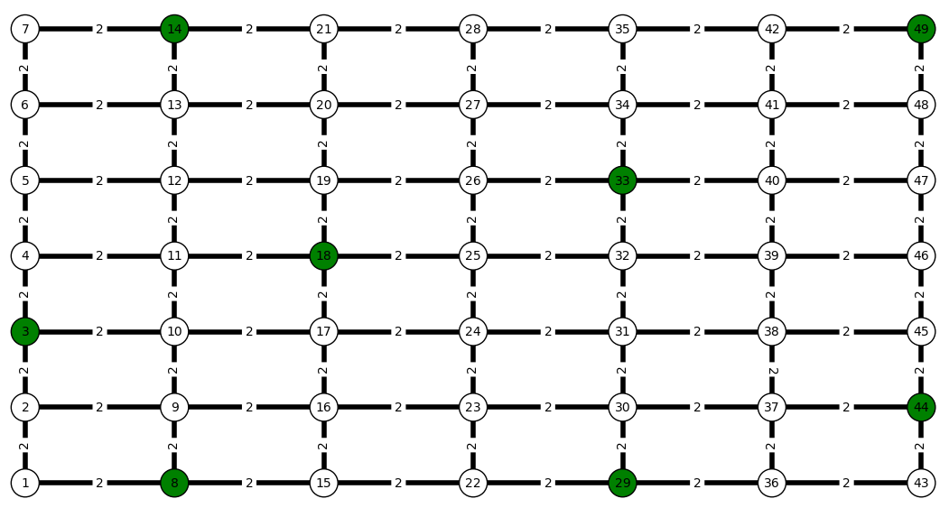
Results: 1st Example, Grid (budget = 24)

Slide 18
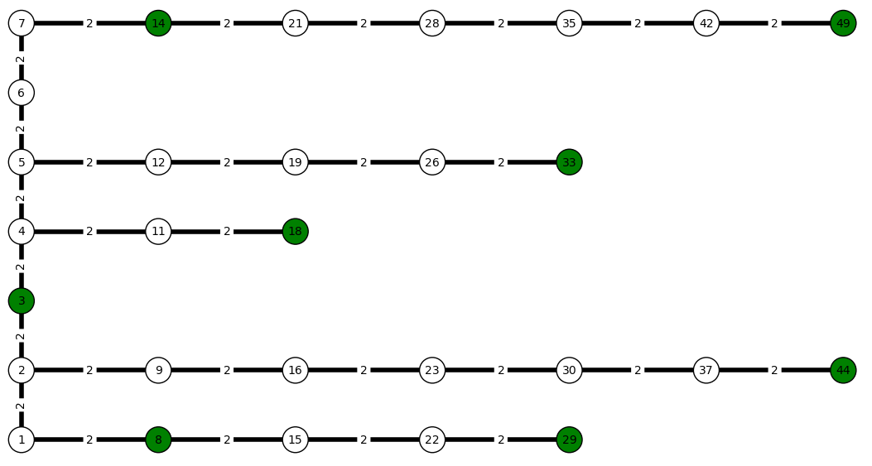
Results: 1st Example, Grid Spanning tree, after pruning non-router leaves

Slide 19
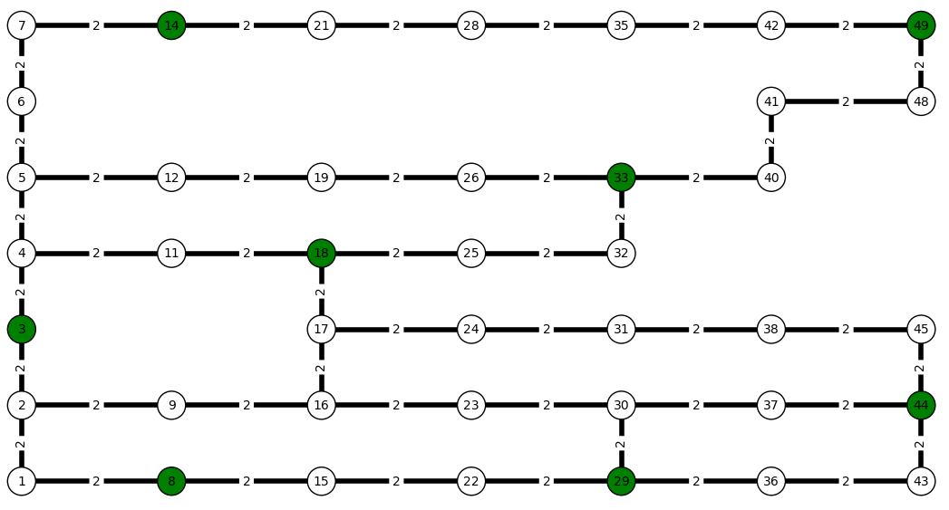
Results: 1st Example, Grid After running MM-SRLG(cycle)

Slide 20
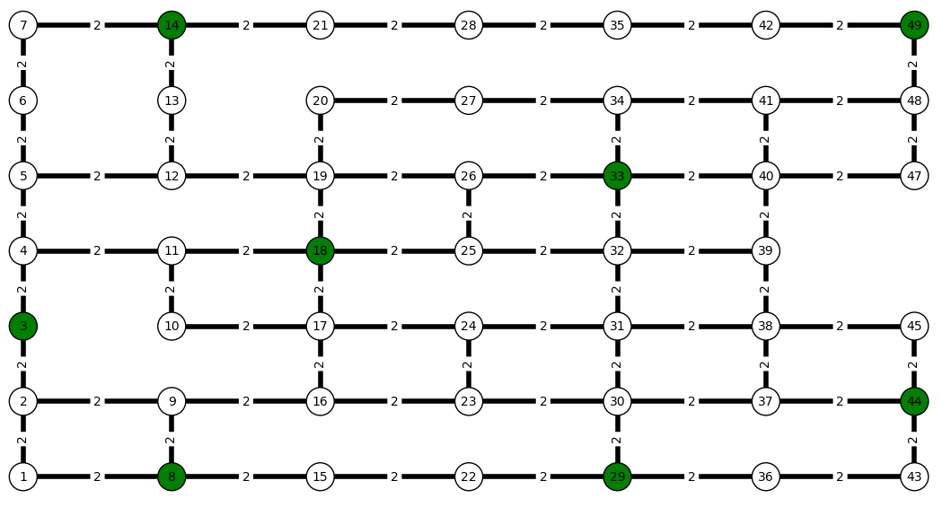
Results: 1st Example, Grid After running MM-SRLG(arb)

Slide 21
Results: 1st Example, Grid
Budget = 8 Bandwidth before link failure:
MM-SRLG | 9.77 Gbits/sec
Disjoint Paths | 9.92 Gbits/sec

Slide 22
Results: 1st Example, Grid
Budget = 24 Bandwidth before link failure:
MM-SRLG | 10.06 Gbits/sec
Disjoint Paths | 9.87 Gbits/sec

Slide 23
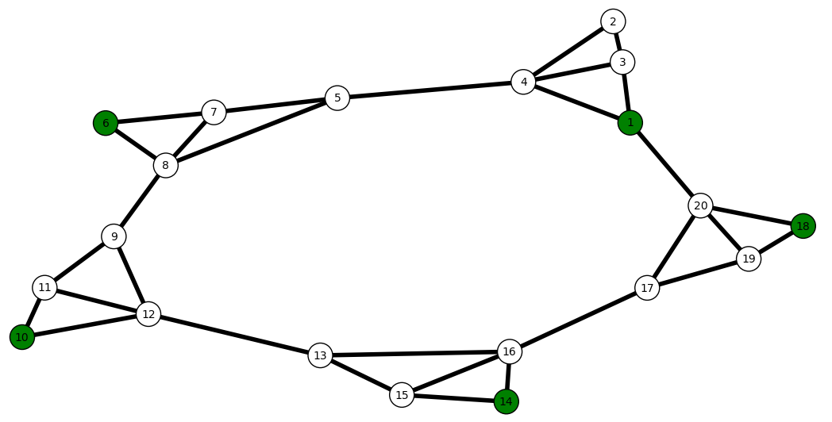
Results: 2nd Example, Caveman Graph

Slide 24
Results: 2nd Example, Caveman Graph
The bandwidth between host 1 and host 18:
Before causing the physical edge (18,20) to fail:
MM-SRLG: 8.17 Gbits/sec
Disjoint Paths: 7.99 Gbits/sec
After causing the physical edge (18,20) to fail:
MM-SRLG: 8.36 Gbits/sec
Disjoint Paths: 2.42 Gbits/sec

Slide 25
Thank you!
☺

